Slide 1
Learning Goals/Objectives
Be able to read, comprehend, trace, adapt and create Python code that:
Uses lists to store data
Outputs a range of items from a list
Searches a list to find an item

Slide 2
Output a Range of Items

Slide 3
Variable or List?
Variable - stores one piece of data with an identifier.
player1 = Mary
player2 = Sean
player3 = Atif
List - stores more than one piece of data with the same identifier.
players = [“Mary”, “Sean”, “Atif”]
Notes:
Variables only store 1 piece of data using the same identifier. Lists can store many.
You can tell a list because it uses square brackets.

Slide 4
List Range - How To Code
We can output a range from a list by customising the print command.
This will start at index 2 (grapes).
fruits = [“apple”, “banana”, “grapes”, “strawberry”, “orange”]
print(fruits[2:4])
This will end at index 3 (strawberry). The end number in the brackets is NOT included.
Use the list name in the print command.
Notes:
The start index is included.
The end index is NOT included, make it one more than the desired end item.

Slide 5
List Range - Variations
fruits = [“apple”, “banana”, “grapes”, “strawberry”, “orange”]
print(fruits[:4])
print(fruits[2:])
Outputs from the beginning up to index 3 (strawberry). The end number in the brackets is NOT included.
Outputs from index 2 (grapes) to the end of the list.
Notes:
The start index is included.
The end index is NOT included, make it one more than the desired end item.

Slide 6
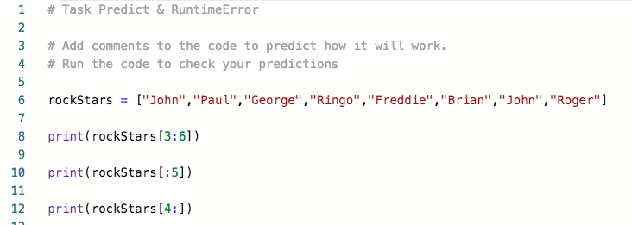
Task - Predict & Run

Slide 7
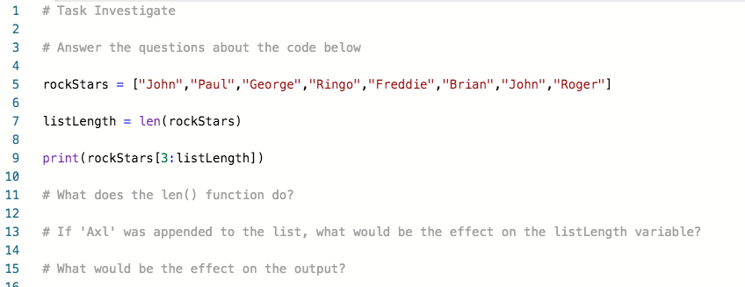
Task - Investigate

Slide 8
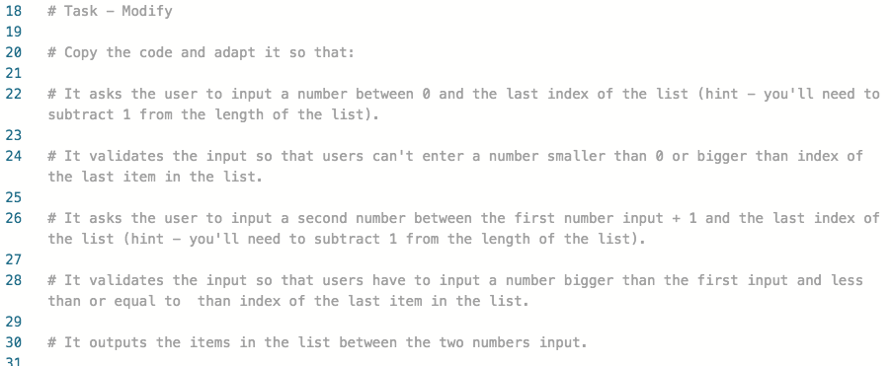
Task - Modify
Notes:
Students must remember the lessons on casting to convert input to int and output to string.
Every time they get a number input, they should cast it to an int.
Every time they output a number, they should cast it to a string.
Also get them to count the number of opening/closing brackets on a line when debugging.
They will need to use the +1 and -1 to get the numbers to display properly in the output messages. They should put this in brackets - (listLength - 1) etc. Have a look at the solution and run it a couple of times to familiarise yourself.

Slide 9
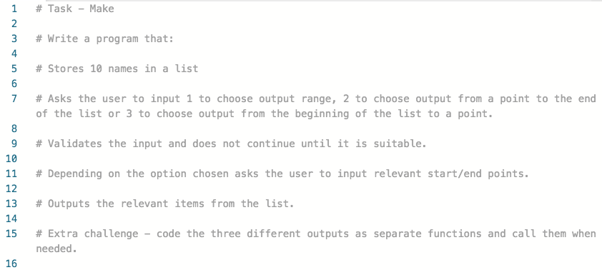
Task - Make

Slide 10
Search A List

Slide 11
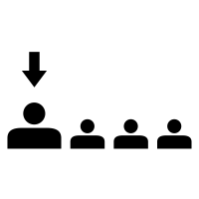
Linear Search
Linear
‘Resembling a line’.
Searching each item of data one after the other, starting with the first.
(Move along the line)

Slide 12


Pets[ ]
0 1 2 3 4
Notes:
Where’s the kitten?
Get students to work through the list, starting at 0 and comparing each item to kitten.
Explain about linear search and that this is how a computer does it.

Slide 13
Search A List - How To Code - Method 1
Using a while loop
Initialise a counter variable to 0 to keep track of how many times the loop has run.
counter = 0
found = False
2. Initialise a found variable to false. We will change this to true when/if we find our item in the list.
Notes:
When using a While loop to search a list we need to include 2 variables:
counter - to keep track of the number of times the loop runs (initialise as 0 before the loop starts and increment by 1 inside the loop). You may often see this variable called i (for index) in code examples. That’s the traditional name for it
Found - a Boolean (true/false) variable to store whether we have found the item or not (initialise as false outside the loop because we haven’t started looking yet, so we haven’t found our item yet).
This example runs over several slides to help you build up the full code with students.

Slide 14
Search A List - How To Code - Method 1
Using a while loop
counter = 0
found = False
while counter < len(list):
3. Start a while loop. Set the condition to be while the counter variable is less than the length of the list.
Notes:
Students may ask why use less than (or you can ask them). It’s because len returns the number of items in a list. However list indexing starts at 0, so a list with 8 items will have indexes 0-7. In this situation the condition is counter < 8, which means it will stop at 7. Perfect!

Slide 15
Search A List - How To Code - Method 1
Using a while loop
4. Use selection. Use counter as the index of the item in the list that is being examined. If it is the same as the item we’re looking for then set found to True.
counter = 0
found = False
while counter < len(list):
if list[counter] == itemLookingFor:
found = True
counter +=1
5. OUTSIDE the selection but INSIDE the loop, increment counter by 1.
Notes:
This is the trickiest part to comprehend. counter is used to denote the index of the item in the list that we are currently looking at. counter will go up by one every time so this will move the program along the list one by one in a linear search pattern.
The program compares the current item from the list with the item we want to find. If they are the same then it sets found to True to indicate that the item has been found.
Students often think that the program will stop when the item is found. This example is inefficient because it doesn’t. It searches the whole list regardless (see truth table example later on).

Slide 16
Search A List - How To Code - Method 1
counter = 0
found = False
while counter < len(list):
if list[counter] == itemLookingFor:
found = True
counter +=1
if found == True:
print(itemLookingFor + “ has been found in the list”)
else:
print(itemLookingFor + “ is not in the list”)
4. AFTER the loop,use selection to display a message about whether the item was found or not.
Notes:
This is the trickiest part to comprehend. counter is used to denote the index of the item in the list that we are currently looking at. counter will go up by one every time so this will move the program along the list one by one in a linear search pattern.
The program compares the current item from the list with the item we want to find. If they are the same then it sets found to True to indicate that the item has been found.
Students often think that the program will stop when the item is found. This example is inefficient because it doesn’t. It searches the whole list regardless (see truth table example later on).

Slide 17
Search A List - How To Code - Method 1
list = [“pencil”, “ruler”, “pen”, “eraser”, “calculator”]
itemLookingFor = “pen”
counter = 0
found = False
while counter < len(list):
if list[counter] == itemLookingFor:
found = True
counter +=1
if found == True:
print(itemLookingFor + “ has been found in the list”)
else:
print(itemLookingFor + “ is not in the list”)
itemLookingFor | counter | found | list[counter]
pen | 0 | False
Notes:
These slides show how the process works using a truth table.
I’ve added the itemLookingFor and list[counter] columns to make the process more visible.
The table is filled up to the start of the loop.

Slide 18
Search A List - How To Code - Method 1
list = [“pencil”, “ruler”, “pen”, “eraser”, “calculator”]
itemLookingFor = “pen”
counter = 0
found = False
while counter < len(list):
if list[counter] == itemLookingFor:
found = True
counter +=1
if found == True:
print(itemLookingFor + “ has been found in the list”)
else:
print(itemLookingFor + “ is not in the list”)
itemLookingFor | counter | found | list[counter]
pen | 0 | False
pen | 0 | False | pencil
Notes:
This line is the first iteration of the loop.

Slide 19
Search A List - How To Code - Method 1
list = [“pencil”, “ruler”, “pen”, “eraser”, “calculator”]
itemLookingFor = “pen”
counter = 0
found = False
while counter < len(list):
if list[counter] == itemLookingFor:
found = True
counter +=1
if found == True:
print(itemLookingFor + “ has been found in the list”)
else:
print(itemLookingFor + “ is not in the list”)
itemLookingFor | counter | found | list[counter]
pen | 0 | False
pen | 0 | False | pencil
pen | 1 | False | ruler

Slide 20
Search A List - How To Code - Method 1
list = [“pencil”, “ruler”, “pen”, “eraser”, “calculator”]
itemLookingFor = “pen”
counter = 0
found = False
while counter < len(list):
if list[counter] == itemLookingFor:
found = True
counter +=1
if found == True:
print(itemLookingFor + “ has been found in the list”)
else:
print(itemLookingFor + “ is not in the list”)
itemLookingFor | counter | found | list[counter]
pen | 0 | False
pen | 0 | False | pencil
pen | 1 | False | ruler
pen | 2 | True | pen
Notes:
Students may think that the loop stops here. IT DOESN”T - it’s programmed to run until counter reaches the length of the list.

Slide 21
Search A List - How To Code - Method 1
list = [“pencil”, “ruler”, “pen”, “eraser”, “calculator”]
itemLookingFor = “pen”
counter = 0
found = False
while counter < len(list):
if list[counter] == itemLookingFor:
found = True
counter +=1
if found == True:
print(itemLookingFor + “ has been found in the list”)
else:
print(itemLookingFor + “ is not in the list”)
itemLookingFor | counter | found | list[counter]
pen | 0 | False
pen | 0 | False | pencil
pen | 1 | False | ruler
pen | 2 | True | pen
pen | 3 | True | eraser
Notes:
Point out that found stays true. There is no code that resets it inside the loop. It is used to store whether the item looking for is in the loop or not.

Slide 22
Search A List - How To Code - Method 1
list = [“pencil”, “ruler”, “pen”, “eraser”, “calculator”]
itemLookingFor = “pen”
counter = 0
found = False
while counter < len(list):
if list[counter] == itemLookingFor:
found = True
counter +=1
if found == True:
print(itemLookingFor + “ has been found in the list”)
else:
print(itemLookingFor + “ is not in the list”)
itemLookingFor | counter | found | list[counter]
pen | 0 | False
pen | 0 | False | pencil
pen | 1 | False | ruler
pen | 2 | True | pen
pen | 3 | True | eraser
pen | 4 | True | calculator
Notes:
Point out that found stays true. There is no code that resets it inside the loop. It is used to store whether the item looking for is in the loop or not.

Slide 23
Search A List - How To Code - Method 1
list = [“pencil”, “ruler”, “pen”, “eraser”, “calculator”]
itemLookingFor = “pen”
counter = 0
found = False
while counter < len(list):
if list[counter] == itemLookingFor:
found = True
counter +=1
if found == True:
print(itemLookingFor + “ has been found in the list”)
else:
print(itemLookingFor + “ is not in the list”)
itemLookingFor | counter | found | list[counter]
pen | 0 | False
pen | 0 | False | pencil
pen | 1 | False | ruler
pen | 2 | True | pen
pen | 3 | True | eraser
pen | 4 | True | calculator
 | 5
Notes:
The counter variable is incremented before the loop finishes, so it goes up to 5.

Slide 24
Search A List - How To Code - Method 2
list = [“pencil”, “ruler”, “pen”, “eraser”, “calculator”]
itemLookingFor = “pen”
counter = 0
found = False
while counter < len(list):
if list[counter] == itemLookingFor and found == False:
found = True
counter +=1
itemLookingFor | counter | found | list[counter]
pen | 0 | False
pen | 0 | False | pencil
pen | 1 | False | ruler
pen | 2 | True | pen
 | 3
Notes:
This is how to code so that the loop stops once the item is found. The Boolean variable ‘found’ is used as a flag. If the item being inspected is the one we’re looking for the flag is set to true. The loop uses an and so both conditions have to be true (the flag has to be ‘false’. This means that the loop will stop once found = False or counter is >= the length of the list.

Slide 25
Search A List - How To Code - Method 3
list = [“pencil”, “ruler”, “pen”, “eraser”, “calculator”]
itemLookingFor = “pen”
if itemLookingFor in list:
print(itemLookingFor + “ has been found in the list”)
else:
print(itemLookingFor + “ is not in the list”)
Notes:
This is a HUGE python shortcut. It works in the same way as examples 1 & 2, but is more opaque. Examples 1 & 2 really help students to understand how the search works.

Slide 26
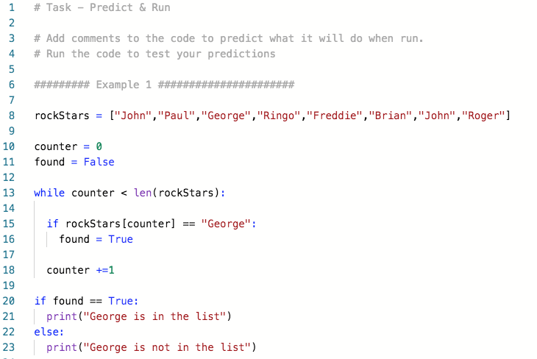
Task - Predict & Run

Slide 27
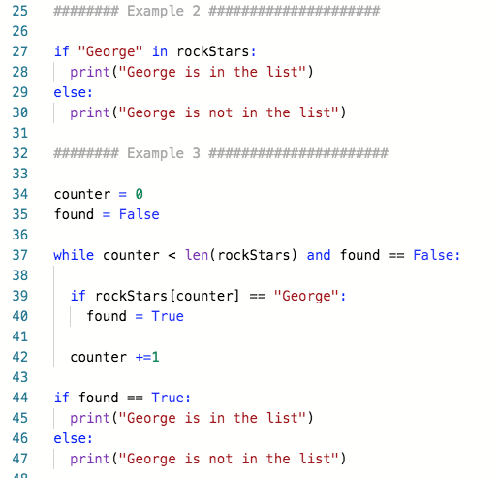
Task - Predict & Run

Slide 28
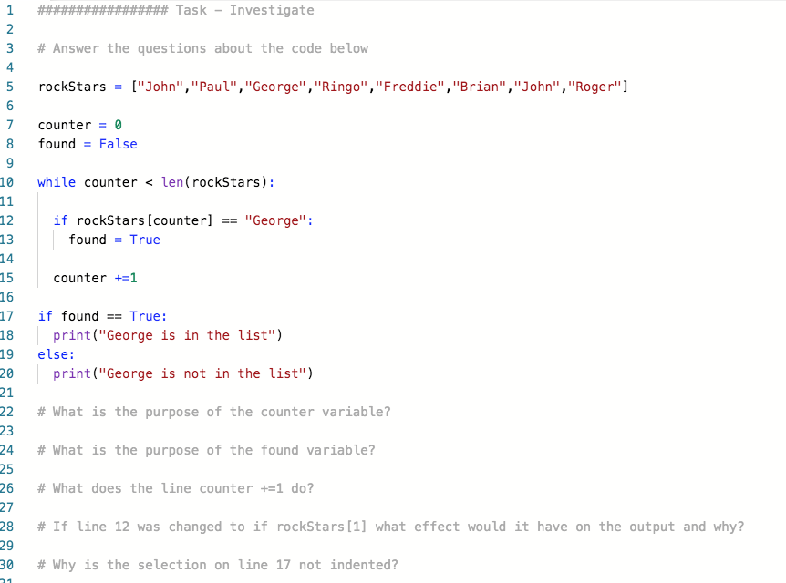
Task - Investigate

Slide 29
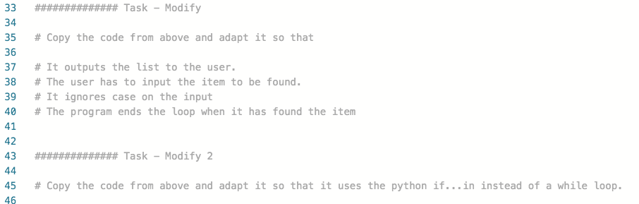
Task - Modify

Slide 30
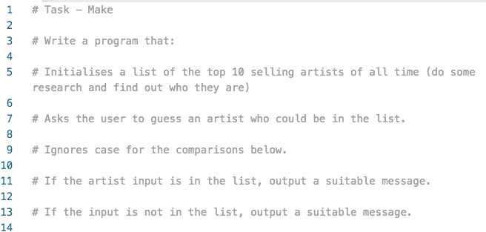
Task - Make

